Slide 1


Rent Review 2013/14

Slide 2

Agenda
The Council’s Budgets
The Housing Revenue Account
Housing Subsidy – A Reminder
The New System
Your Priorities
Highlights from 2012
Challenges in 2013
Our plans 2013/14
Rents in 2013/14

Slide 3


The Council’s Budget
General Fund Account
£46.8m
Housing Revenue Account
Capital Programme
£68.2m
£15.2m
£6.2m

Slide 4
The Housing Revenue Account

Slide 5
Housing Subsidy – A Reminder
£’000
We have paid DCLG £21.5m since 2005/06
116% increase since 2005/06

Slide 6
The New System
Previously, around a third of our rental income went to the government
In April 2012, the new funding system for council housing was introduced
We do not have to pay the government negative housing subsidy
Debt management and servicing costs replaced subsidy
A 30 year Business Plan helps us to manage the service

Slide 7
The Benefits of the New System
All rental income to be kept locally
Enables KBC to actively manage its assets
Business Planning – Greater Certainty

Slide 8

The Benefits of the New System

Slide 9

Your Priorities
Tenants Forum looked at priorities in January and November 2012
You told us that your top priorities were:
    Improving the Housing Stock
    Investing in day-to-day services – tenancy support, fighting fraud, sign-ups and introductory tenancies
    Building new homes - when the time is right

Slide 10
Your Priorities
Tenants Forum looked at priorities in January and November 2012
You told us about the housing service you wanted:
Low rent, low quality | ✗
Reasonable rent and reasonable quality | ✓
High rent, high quality | ✗

Slide 11
Highlights from 2012
March: HRA self-financing regime introduced
April: Rent arrears driven down to £161,450
May: Launching Community Harm Statements
August: Establishing the Tenant Overview and Scrutiny Panel
September: ARCH tenants Conference in Kettering
October: New Tenancy Policy
November: New Keyways Allocations Policy

Slide 12
Challenges in 2013
Making sure that council housing is fit-for-purpose, easy to let and continues to meet local needs
Managing the impact of welfare reform and supporting our tenants
Focusing more on tenancy management
Planning for the future of housing-related support (Supporting People)

Slide 13
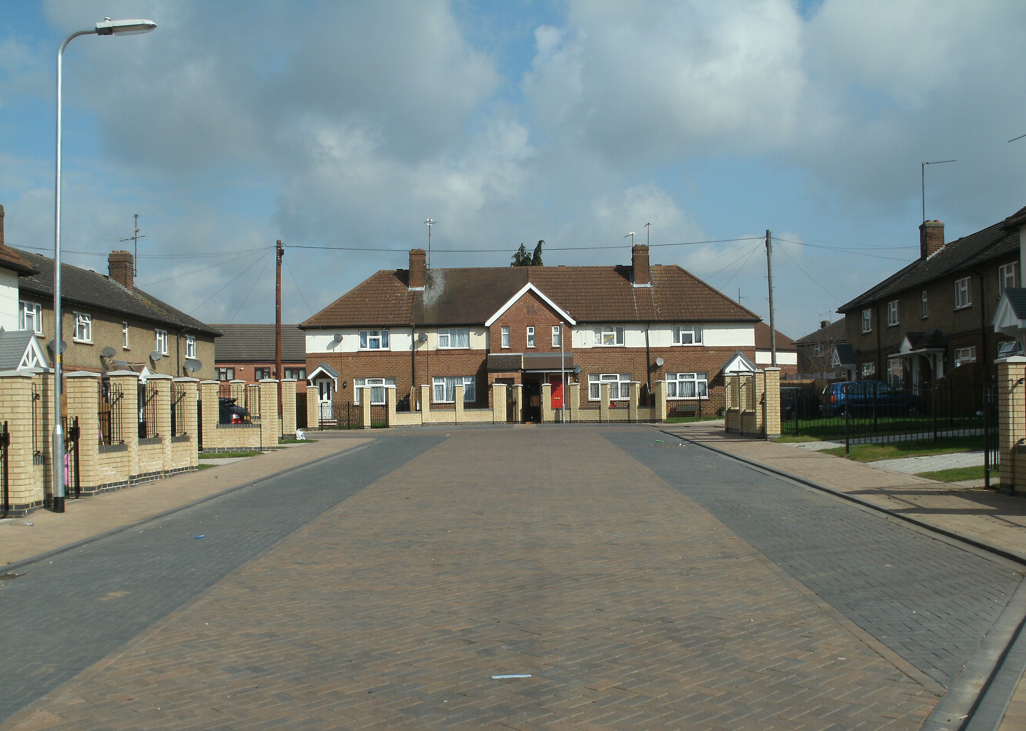
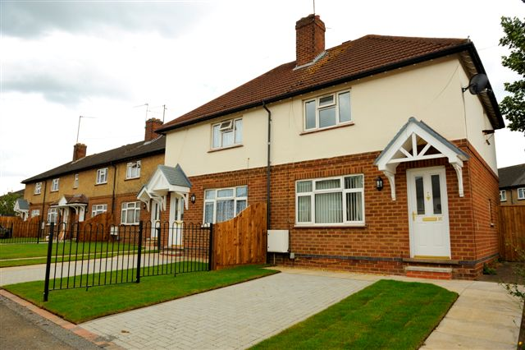
Our Plans for 2013/14
Tenancy Policy
New allocations policy
Flexible tenancies
Tenancy fraud
Sign-ups
Welfare reform
Improving practical advice and support
Asset management
New target times for repairs
Homes for the Future programme
Processes for managing capital projects

Slide 14




Our Plans for 2013/14
Sheltered housing
Strategic review
Improving day-to-day services
Out-of-hours
Estate cleaning
Aids and adaptations
People with special needs
Health and wellbeing
Ex-offenders
Customer satisfaction
STAR tenant satisfaction survey

Slide 15
Previous Increases
Year | Percentage increase (%)
2008/09 | 7.5
2009/10 | 6.4
2010/11 | 3.1 (6.2% before gov't intervention)
2011/12 | 7.0
2012/13 | 7.9

Slide 16
Rents 2013/14 - Our Recommendation
  Average rent increase - 4.75%
  Average weekly rent per property - £75.58
  Average weekly increase - £3.43

