Slide 1
Kettering
The Health and Wellbeing Strategy for Northamptonshire
Peter Watson, Kettering Senior Locality Manager, Nene CCG

Slide 2
Introduction
One of the main tasks of the Northamptonshire Health and Wellbeing Board is to establish a countywide Health and Wellbeing Strategy for Northamptonshire
Northamptonshire Public Health is currently leading on the strategy development with support from local partners
Through consultation with local stakeholders, eight main objectives have been identified to focus on for the next three years

Slide 3
What is the strategy for?
This is an important strategy for people and organisations of Northamptonshire. Nothing matters more to people than their own health and wellbeing and that of their families. Good health and wellbeing is, quite simply, vital to a safe, satisfying and successful life.
Public Consultation
The next stage of development for the strategy is to engage with members of the public, patients, carers and service users on the proposed eight objectives in Northamptonshire and importantly the endorsement for the proposed objectives in the strategy

Slide 4
Public Consultation
A formal consultation took place over the summer seeking the views of the emerging locality Health and Wellbeing groups on the outcomes and local priorities of the draft strategy
The feedback of this initial consultation has helped to shape the strategy.
We are now on the next phase of consultation and want to hear your views on the draft executive summary. This phase of consultation started on 20th September 2012 and finishes on 14th November 2012

Slide 5
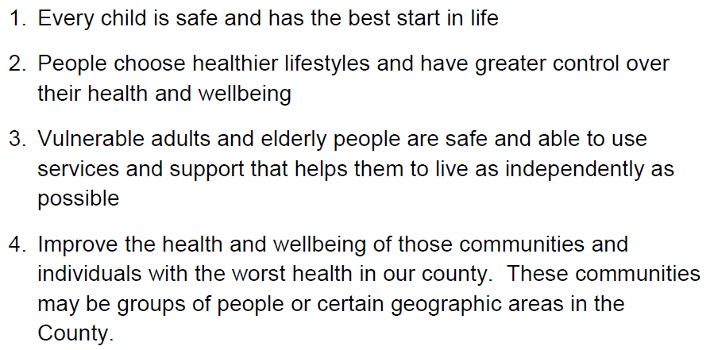
The Strategy

Slide 6
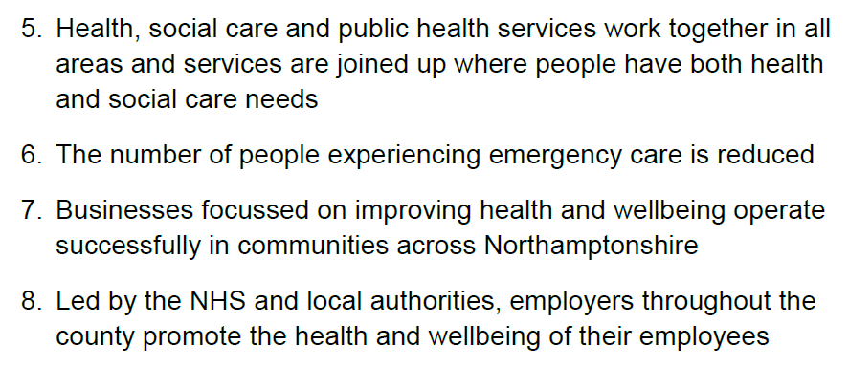
The Strategy

Slide 7
The Health and Wellbeing Board

Slide 8
The Health and Wellbeing Board

Slide 9
In Kettering……
Local “Health and Wellbeing Fora”
Includes representatives from KBC, Voluntary Sector, KGH, NCC, Public Health, NHFT, EMAS, Northants LINk
Chaired by Dr Raf Poggi, Kettering GP and CCG Locality Chair
First Forum to meet in Nene CCG area, has met 3 times
First Forum to submit business case to H&WB Board
Focus on healthy lifestyles, healthy homes, healthy businesses, elderly

