Slide 1
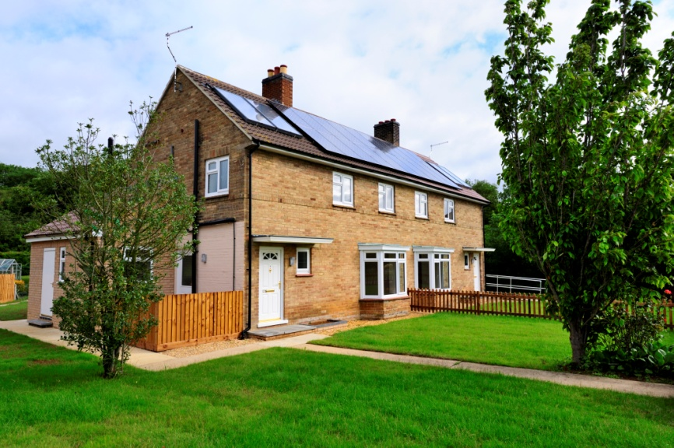

HRA Business Plan

Slide 3
What is the HRA Business Plan?
The Business Plan will be the main tool for managing the Council’s landlord service
It will show how we plan to use your rent payments to manage your homes and neighbourhoods
It will also help us to be more accountable to you

Slide 4
The Plan has to be Sustainable
The Business Plan must be sustainable and show that:
  we can service the debt
  we can maintain your homes in a decent condition
  we can provide services for you to an agreed standard
  and, we don’t run a deficit.

Slide 5
What did you tell us?
1. Your Priorities
There are three alternative options:
Better day-to-day services
Improving the housing stock
Investing in new homes
Score each option out of 10 to show how important it is to your group
2. Quality v Cost
Where do you think we should be on a range where:
0 = Low rent, low quality
10 = High rent, high quality
5 = Reasonable rent and reasonable quality
3. Anything else you would like to say?

Slide 6
What did you tell us?
YOUR PRIORITIES | Table1 | Table 2 | Table3 | Total
Better day-to-day services | 9 | 2 | 9 | 20
Improving the housing stock | 8 | 8 | 9 | 25
Investing in new homes | 7 | 10 | 2 | 19

Slide 7
What did you tell us?
QUALITY V COST | Table 1 | Table 2 | Table 3
Score | 5 | 9 | 6.5
Average | 6.83
0 = Low rent, low quality
10 = High rent, high quality
5 = Reasonable rent and reasonable quality

Slide 8
The Challenges
Making sure that council housing continues to meet local needs
Ensuring our housing is fit-for-purpose and easy to let
Welfare reform
Supporting People
Tenancy Policy
Providing practical support and advice to tenants

Slide 9
Short Term Priorities
Developing our skills and expertise
Establishing the Tenants Overview and Scrutiny Panel
Verifying and updating our stock condition data
Improving performance and value for money

Slide 10
Long Term Priorities
A more strategic approach to neighbourhood management
Making greater use of tenant satisfaction surveys
Reviewing IT systems
Strategic review of sheltered housing
Looking at the feasibility of new build
Investing in more tenancy support

Slide 11
Investing in Your Homes
A balanced asset management strategy
  Homes for the Future - Major investment in housing built before 1945
  Decent Homes – Planned maintenance programmes
  Environmental improvements
  Responsive and reliable day-to-day repairs service
More investment in disabled adaptations

Slide 12

And now……. over to you!

Slide 13
This is what we do......
Letting properties | Publishing ‘Connect’
Collecting rents & service charges | Tackling tenancy fraud
Supporting vulnerable tenants | Cleaning internal communal areas
Doing repairs | Running life skills training courses
Providing information to tenants | Providing sheltered housing
Consulting tenants | Keeping estates tidy
Improving homes and estates | Cutting the grass
Disabled adaptations | Improving security on estates
Tackling anti social behaviour | Dealing with neighbour disputes
Enforcing tenancy conditions

Slide 14
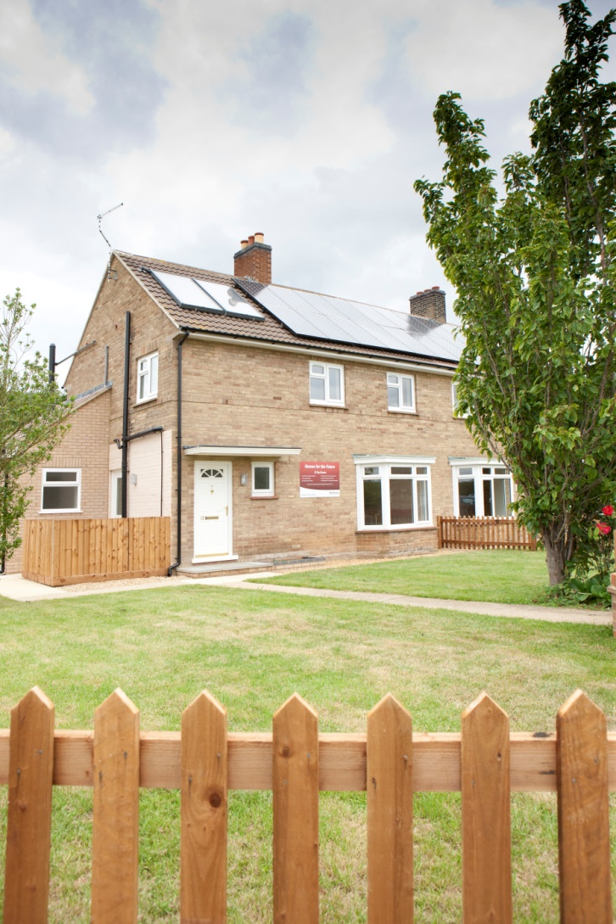
And now.....over to you!
How important is what we do?
What are we doing well?
What could we do better?
What should we do more of?
What should we do less or not at all?

Slide 15
HRA Business Plan

