Slide 1
‘Local Government Reform in Northamptonshire – government decision and next steps’
Geographic Forums:
KTF – 8th July 2019
A6 Towns – 10th July 2019
Rural – 18th July 2019

Slide 2
Things to Cover
Reminder of context
Government Decision & Process
Timescale
Programme Governance
Programme Delivery

Slide 3


…since our last forum in March
We have received a government decision
More opportunities for transformational change
More realistic timescale
Timescale for statutory approval process (secondary legislation)
Still a significant delivery challenge

Slide 4
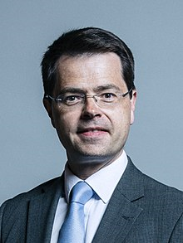
…what we told you last time
Following the government’s statutory consultation, the SoS had three options open to him;
  Not to approve the joint submission
  To approve the joint submission
  To approve the joint submission (with modifications)

Slide 5
…so what was the SoS decision?
The Secretary of State announced his decision via written statement on Tuesday 14th May. The key elements are;
  He decided on option 3 – ‘approve with modification’
  To approve the creation of two new unitary authorities (North and West)
  New authorities will ‘begin’ on 1st April 2021
  Dependant upon two other issues

Slide 6








New Unitary authorities
North Northamptonshire Unitary
West Northamptonshire Unitary

Slide 7
…the dependant issues
  Extract from Ministerial Statement;
  Children’s Trust
  “This is on the basis that there is a Children’s Trust covering the whole of Northamptonshire, which with my support, my Rt Honourable Friend the Secretary of State for Education is minded to establish, as recommended by the Children’s Commissioner, if the unitary proposal is to be implemented”
  Health & Social Care Integration
  “it is also on the basis that work continues to be taken forward in Northamptonshire to do more to integrate adult social care and health services”

Slide 8
Govt Process – Next Steps
Secondary Legislation needs to be laid in Parliament
Main element = draft ‘Structural Change Order’
Full Parliamentary approval process required
This isn’t a quick process!

Slide 9
Structural Change Order
Reminder of what a SCO is
The content is a decision of the Secretary of State
Council’s are liaising with govt officials on the drafting (incl. re-affirming any preferences)

Slide 10
Possible Timescales
May 2019 July Nov May2020
Govt. Decision Announced
Expected secondary legislation laid (SCO)
[prior to summer recess]
Expected final approval of legislation i.e. SCO made
[need a 6 month gap to May ‘20]
Elections for new unitary authorities [+T&PCs and PCC]
Joint Committee (North & West) Operate

Slide 11
Possible Timescales
May ‘20 Feb ‘21 Mar ‘21 Apr ‘21
Shadow Arrangements in Place?
[Existing LAs continue to exist and operate]
New authorities operational [01/04/21]
Budgets/CT approved for new Unitaries
Existing LAs cease to exist [31/03/21]
Other dates tbc: -
  Statutory appointments
  Meeting schedules

Slide 12
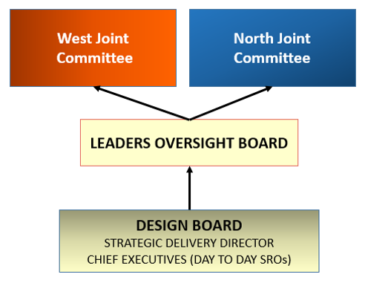
Programme Governance
Each Local Authorities own Governance Arrangements – for example, at KBC;
Local Govt Reform Advisory Committee
Full Council
Links into

Slide 13
GOVERNANCE
West Joint Committee/ Shadow Exec
North Steering Group/ Joint Committee/ Shadow Exec
WEST
SHADOW COUNCIL GOVERNANCE
NORTH
SHADOW COUNCIL
GOVERNANCE
Member working groups
Commissioners
LEADERS OVERSIGHT BOARD
Member working groups
DESIGN BOARD
STRATEGIC DELIVERY DIRECTOR
CHIEF EXECUTIVES (DAY TO DAY SROs)
Leading to
2 x IMPLEMENTATION BOARDS
Discovery and Design working group - LEADERS
Discovery and Design working group - LEADERS
Key:
*Existing
DELIVERY PROGRAMMES
*Existing
ENABLER WORKSTREAMS
New

Slide 14
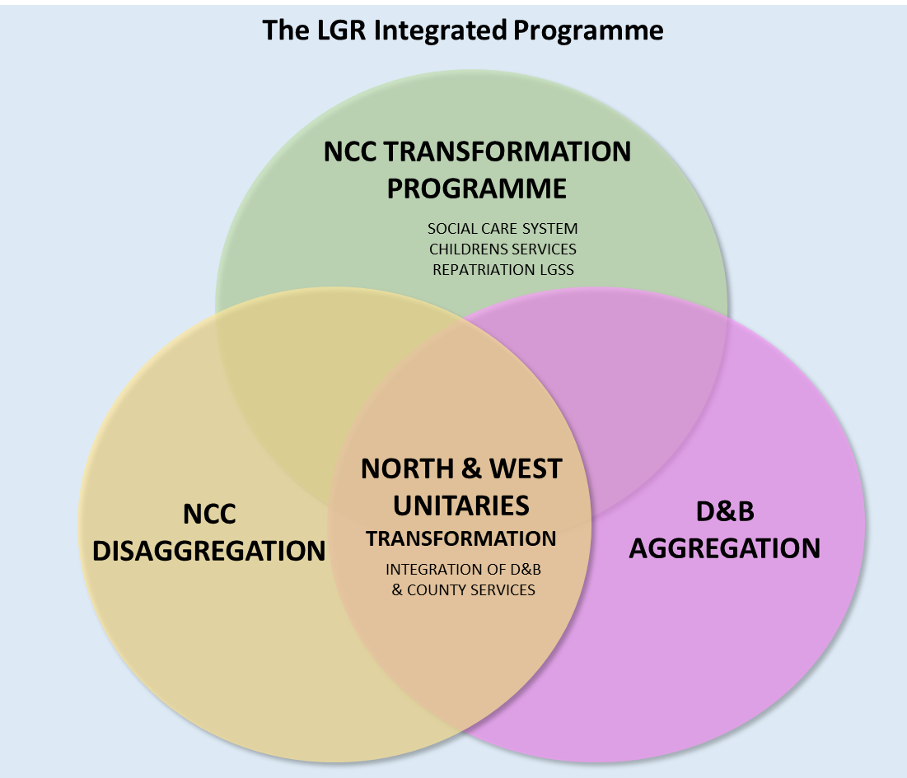

Slide 15
Programme Phases
April 2019 April 2021
LEADER OVERSIGHT BOARD
DESIGN BOARD
IMPLEMENTATION BOARDS
PHASE
OUTPUTS
DISCOVERY
DESIGN
PLANNING
IMPLEMENTATION
STABILISATION
BASELINE
BLUEPRINT X 2
2 NEW COUNCILS
DELIVERY PLANS

Slide 16
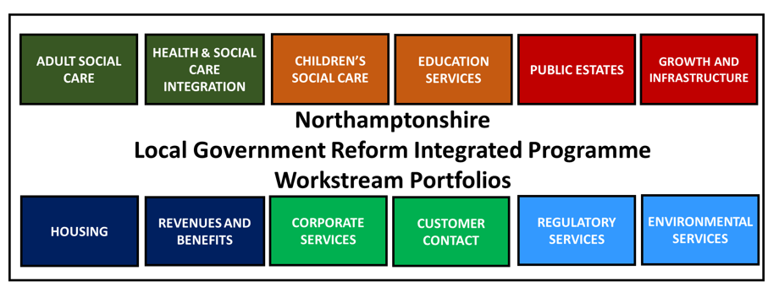
Programme Workstreams

Slide 17
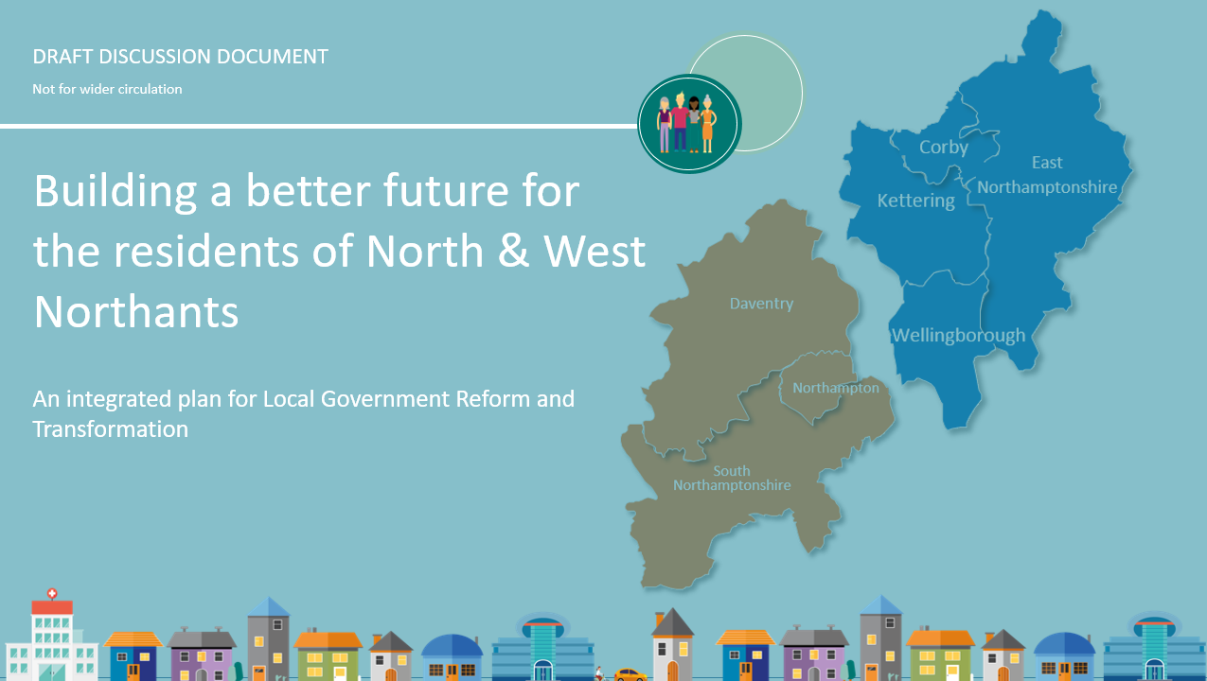
The Prospectus!

