Slide 1
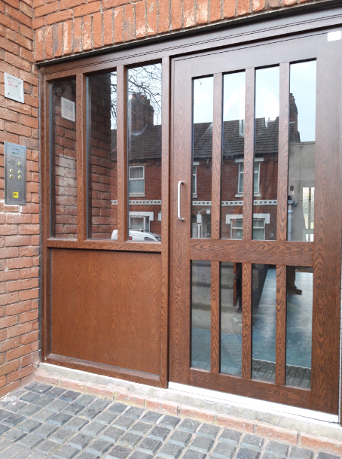


Asset Management Report
Tenant Forum
February 2019
(based on December 2018 data)
Door Entry System – Town Centre, Kettering

Slide 2
Programme Update
Programme | 18/19 target | Apr | May | Jun | Jul | Aug | Sep | Oct | Nov | Dec |  | Jan |  | Feb |  | Mar |  | Year to date
 |  | C | C | C | C | C | C | C | C | C | T | C | T | C | T | C | T
H420 Aids & Adaptions (LAS) | 36 | 2 | 2 | 3 | 2 | 2 | 4 | 1 | 4 | 1 | 1 | - | 2 |  |  |  |  | 21
H435 Bathrooms | 11 | 1 | 1 | 1 | 1 | 2 | 1 | 0 | 1 | 0 | 0 | - | 1 |  |  |  |  | 8
H435 Kitchens incl. 23 Cat1s | 38 | 1 | 1 | 1 | 1 | 2 | 2 | 1 | 7 | 18 | 18 | - | 2 |  |  |  |  | 34
H440 Door Entry Systems | 46 9 blks | - | - | - | - | - | - | - | 40 | 6 | 6 | - |  | - |  | - |  | 46
H442 Boilers | 160 | 16 | 25 | 30 | 37 | 26 | 29 | 16 | 20 | 24 |  | - |  |  |  |  |  | 223
H443 Roofing | 50 | 0 | 4 | 6 | 4 | 4 | 6 | 6 | 8 | 16 | 16 | - |  | - |  | - |  | 54
H446 GRP Doors | 88 | 3 | 10 | 23 | 11 | 6 | 2 | 9 | 11 | 0 | 0 | - | 4 |  |  |  |  | 75
H461 HFTF Montrose House | 18 | - | - | - | 18 | - | - | - | - | - |  | - |  | - |  | - |  | 18
H463 HFTF Desborough | 3 | 0 | 3 | - | - | - | - | - | - | - |  | - |  | - |  | - |  | 3
C = Completed
T = Target
Not scheduled / TBC
* HHSRS kitchen replacement programme commenced November 2018

Slide 3
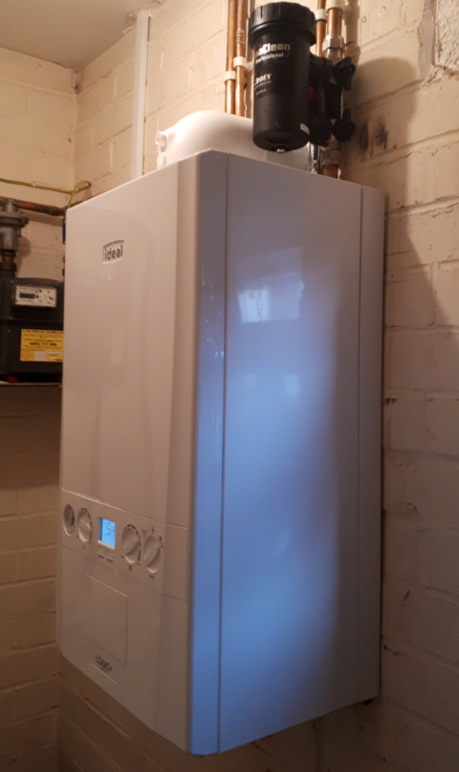
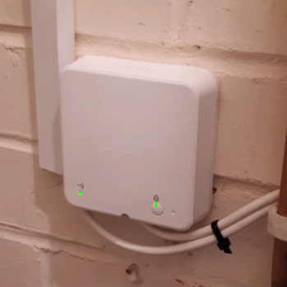
Project Focus
H422 Central Heating / Boilers
Managed by Sarah Parsons
Budget of £276,000.
KBC operatives carry out the adhoc and planned boiler replacement programme.
  Since December, sub-contractor T&S Heating have also been used (via the EEM framework).
    Additional sub-contractors used to cope with demand, as replacements are reactive.
    Demand for replacement of Chaffoteaux boilers due to the failures on this type of boiler.
Ideal Logic and Potterton Assure boilers are being used moving moved (more cost effective).
Annual Gas Safety Checks are carried out annually – this is a compliance check set by Gas Safe.
  No access – warrants served.
Currently reviewing Gas Service policies
and procedures with NICEIC.

Slide 4
Finance Update
Programme | Working budget | Spend to date (£) | Spend to date (%) | Projection | Variance (under) over
H420 Aids & Adaptions | 250,000 | 154,000 | 61 | 250,000 | 0
H430 Electrical Upgrades | 58,000 | 45,000 | 78 | 58,000 | 0
H435 Kitchens & Bathrooms | 375,000 | 187,000 | 50 | 375,000 | 0
H440 Door Entry Systems | 100,000 | 77,000 | 77 | 100,000 | 0
H441 Windows | 29,000 | 26,000 | 90 | 29,000 | 0
H442 Central Heating / Boilers | 357,000 | 320,000 | 90 | 357,000 | 0
H443 Roofing | 156,000 | 203,000 | 130 | 229,000 | 73,000
H446 External GRP Doors | 80,000 | 59,000 | 74 | 80,000 | 0
H447 Void Works | 849,000 | 673,000 | 79 | 849,000 | 0
H448 Structural Improvements | 4,000 | 4,000 | 100 | 4,000 | 0
H450 Environmental Improvements | 60,000 | 63,000 | 105 | 60,000 | 0
H456 Fire Precautions (doors) | 25,000 | 10,000 | 40 | 14,000 | (11,000)
H461 HFTF Hampden Crescent A | 929,000 | 900,000 | 97 | 929,000 | 0
H462 Fire Precautions | 30,000 | 21,000 | 70 | 30,000 | 0
H473 Sparkle Programme | 53,000 | 49,000 | 92 | 53,000 | 0
H475 Housing Association Grant | 55,000 | 0 | 0 | 55,000 | 0
H477 Scott Road New Build | 2,904,000 | 34,000 | 1 | 53,000 | (2,851,000)
H478 New Build Albert Street | 862,000 | 12,000 | 1 | 35,000 | (827,000)
H480 Stamford Road Acquisition | 210,000 | 0 | 0 | 210,000 | 0
TOTALS | 7,386,000 | 2,837,000 | 38% | 3,770,000 | (3,616,000)
Working budgets include fixed costs of running the service.
The revised budget is subject to approval by full council on 27th February 2019.

Slide 5
Performance Tracker
Programme | 18/19 target | Apr | May | Jun | Jul | Aug | Sep | Oct | Nov | Dec |  | Jan |  | Feb |  | Mar |  | Year to date
 |  | C | C | C | C | C | C | C | C | C | T | C | T | C | T | C | T
Decent Homes | 9% | 11.13 | 11.07 | 10.86 | 10.72 | 10.73 | 10.49 | 10.45 | 10.50 | 10.60 |  | - |  |  |  |  |  | 10.60%
SAP Ratings | D | 64.54 | 64.54 | 64.55 | 64.55 | 64.55 | 64.56 | 64.56 | 64.58 | 64.81 |  | - |  |  |  |  |  | D
Percentage of valid *AGSCs | 100% | 98.6 | 98.4 | 98.2 | 98.3 | 98.4 | 98.4 | 99.4 | 99.9 | 99.7 |  | - |  |  |  |  |  | 99.7%
Stock Condition Surveys | 400 | 15 | 18 | 18 | 50 | 20 | 25 | 31 | 3 | 0 | 0 | - | 0 |  |  |  |  | 180
Satisfaction Surveys | 45% | 3 | 3 | 3 | 9 | 2 | 5 | 6 | 11 | 9 | 4 | - | 1 |  |  |  |  | 48%
Energy Performance Certificate (EPC) show energy current and potential energy rating of a property, known as ‘SAP’ ratings, divided into bands ranging A – G (D = 55 – 68).
Annual Gas Safety Check (AGSC) compliance rate.
C = Completed
T = Target
Not scheduled / TBC
Suggestion from resident’s satisfaction survey – HHSRS works in Desborough
“Told it was going to take 10 working days, but it took just over 12. Maybe the contractor should say 10-15 days to allow for any problems that may delay the process.”

